Slide 1

Hospital Management System
GOWTHAM REDDY AVULA

Slide 2
INTRODUCTION
Hospital Management System is a structured relational database designed to manage the core operations of a hospital. It provides a robust framework for storing and retrieving information related to patients, doctors, appointments, medical records, treatments, billing, departments, and staff.
The system has been developed using SQL (Structured Query Language) and follows a normalized relational model to ensure data integrity, consistency, security, and efficient querying. It helps streamline hospital operations, maintain accurate patient records, manage appointments and billing, and support effective healthcare management.

Slide 3
FEATURES
Department – Manages hospital departments and their head doctors.
Patient – Stores patient personal, contact, admission, and discharge details.
Doctor – Maintains doctor specialization, qualification, experience, and department details.
Room – Manages room types, charges, floors, and availability.
Appointment – Records patient appointments, visit types, status, and consultation fees.
Admission – Tracks patient admissions, assigned doctors, rooms, and admission reasons.
Medicine – Manages medicine details, prices, stock, manufacturers, and expiry dates.
Prescription – Records medicines prescribed by doctors to patients.
Billing – Manages hospital charges, discounts, total bills, and payment status.
Laboratory Tests – Records tests, results, dates, and test costs.
Hospital Staff – Manages staff roles, departments, salary, and shifts.
Payments – Records payment methods, amounts, transaction IDs, and payment status.
Nurses – Maintains nurse qualifications, experience, shifts, and salary details.
Insurance – Tracks insurance policies, coverage, claims, and claim status.

Slide 4
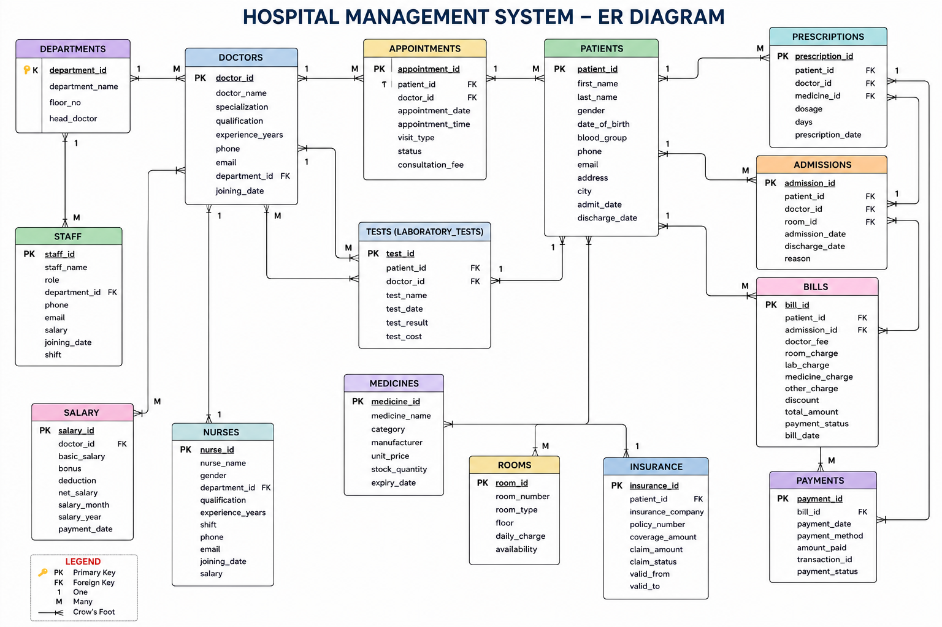
ER Diagram

Slide 5
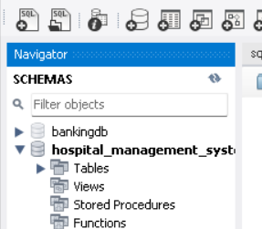
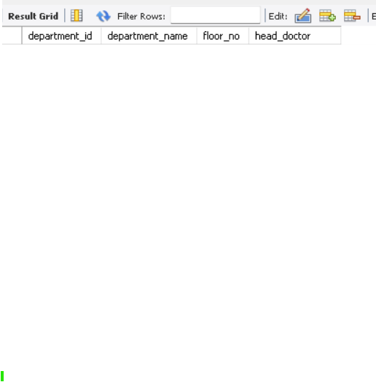
How to Create Database And Table
create schema Hospital_Management_System;
use Hospital_Management_System;
CREATE TABLE Departments ( department_id INT AUTO_INCREMENT PRIMARY KEY, department_name VARCHAR(100) NOT NULL UNIQUE, floor_no INT NOT NULL, head_doctor VARCHAR(100));

Slide 6
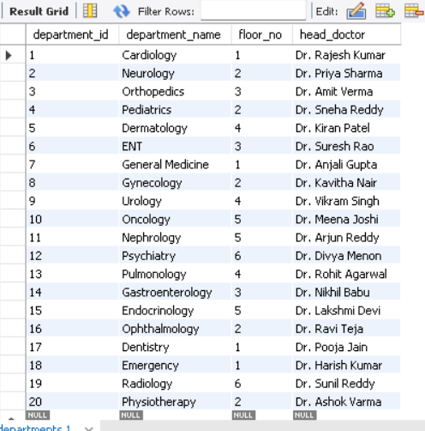
How to Insert values in a table
INSERT INTO Departments (department_id, department_name, floor_no, head_doctor) VALUES(1, 'Cardiology', 1, 'Dr. Rajesh Kumar'),(2, 'Neurology', 2, 'Dr. Priya Sharma'),(3, 'Orthopedics', 3, 'Dr. Amit Verma'),(4, 'Pediatrics', 2, 'Dr. Sneha Reddy'),(5, 'Dermatology', 4, 'Dr. Kiran Patel'),(6, 'ENT', 3, 'Dr. Suresh Rao’);

Slide 7
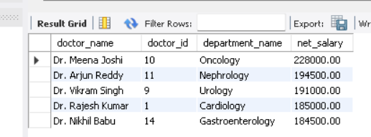
Find the Top 5 Highest Paid Doctors
SELECT d.doctor_name,d.doctor_id, dep.department_name, s.net_salary FROM Doctors d JOIN Salary s ON d.doctor_id = s.doctor_id JOIN Departments dep ON d.department_id = dep.department_id ORDER BY s.net_salary DESCLIMIT 5;

Slide 8
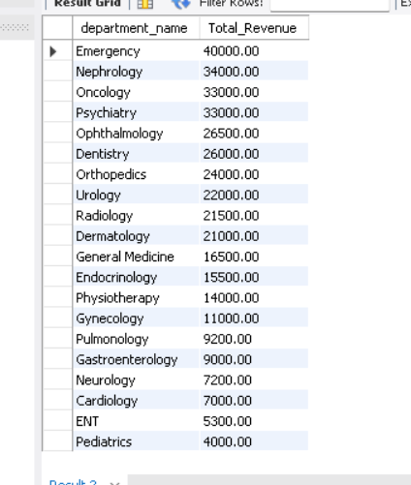
Department-wise Revenue
SELECT dep.department_name, SUM(b.total_amount) AS Total_Revenue FROM Bills b JOIN Admissions a ON b.admission_id = a.admission_id JOIN Doctors d ON a.doctor_id = d.doctor_id JOIN Departments dep ON d.department_id = dep.department_id GROUP BY dep.department_name ORDER BY Total_Revenue DESC;

Slide 9
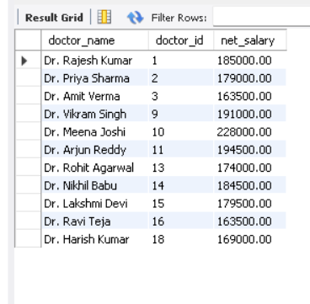
Doctors Earning Above Average Salary
SELECT d.doctor_name, d.doctor_id, s.net_salary FROM Doctors d JOIN Salary s ON d.doctor_id=s.doctor_id WHERE s.net_salary >(SELECT AVG(net_salary)FROM Salary);

Slide 10
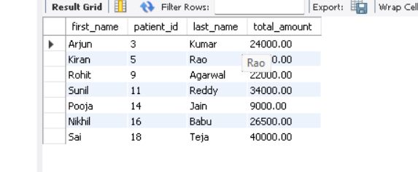
Patients with Pending Bills
SELECT p.first_name,p.patient_id, p.last_name, b.total_amount FROM Patients p JOIN Bills b ON p.patient_id=b.patient_id WHERE b.payment_status='Pending';

Slide 11
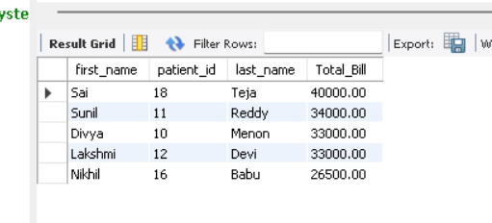
Top 5 Revenue Generating Patients
SELECT p.first_name,p.patient_id, p.last_name, SUM(b.total_amount) Total_Bill FROM Patients p JOIN Bills b ON p.patient_id=b.patient_id GROUP BY p.patient_id,p.first_name,p.last_name ORDER BY Total_Bill DESC LIMIT 5;

Slide 12
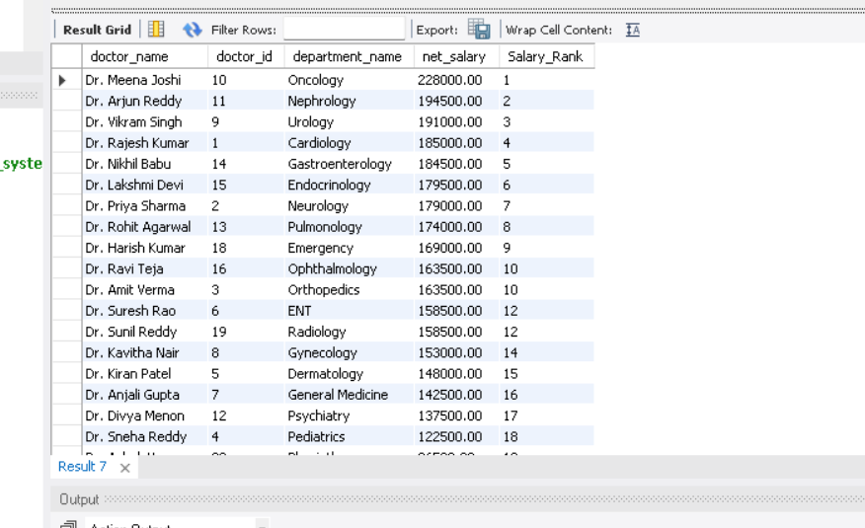
Rank Doctors by Salary
SELECT d.doctor_name,d.doctor_id, dep.department_name, s.net_salary, RANK() OVER(ORDER BY s.net_salary DESC) AS Salary_Rank FROM Doctors d JOIN Salary s ON d.doctor_id=s.doctor_id JOIN Departments depON d.department_id=dep.department_id;

Slide 13
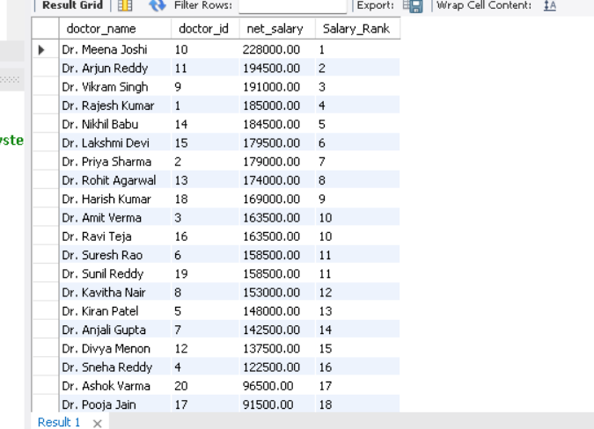
Dense Rank Doctors by Salary
SELECT d.doctor_name,d.doctor_id, s.net_salary, DENSE_RANK() OVER(ORDER BY s.net_salary DESC) AS Salary_Rank FROM Doctors d JOIN Salary s ON d.doctor_id=s.doctor_id;

Slide 14
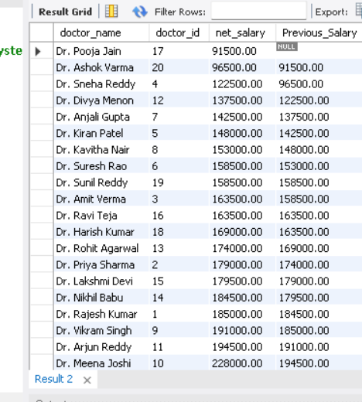
Previous Doctor Salary (LAG)
SELECT d.doctor_name,d.doctor_id, s.net_salary, LAG(s.net_salary) OVER(ORDER BY s.net_salary) AS Previous_Salary FROM Doctors d JOIN Salary s ON d.doctor_id=s.doctor_id;

Slide 15
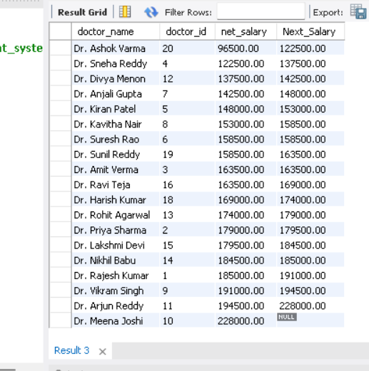
Next Doctor Salary (LEAD)
SELECT d.doctor_name,d.doctor_id, s.net_salary, LEAD(s.net_salary) OVER(ORDER BY s.net_salary) AS Next_Salary FROM Doctors d JOIN Salary s ON d.doctor_id=s.doctor_id;

Slide 16
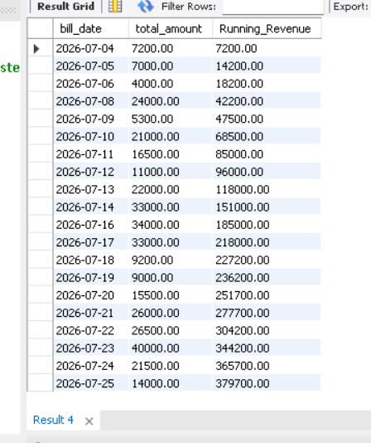
Running Hospital Revenue
SELECT bill_date, total_amount, SUM(total_amount) OVER(ORDER BY bill_date) AS Running_RevenueFROM Bills;

Slide 17
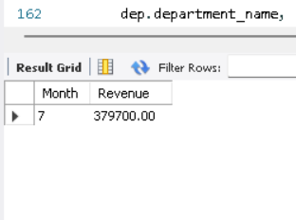
Monthly Revenue Trend
SELECT MONTH(bill_date) AS Month, SUM(total_amount) AS RevenueFROM BillsGROUP BY MONTH(bill_date)ORDER BY Month;

Slide 18
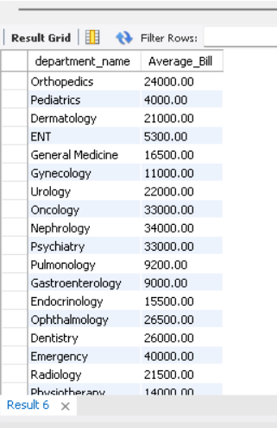
Average Bill by Department
select dep.department_name, ROUND(AVG(b.total_amount),2) AS Average_Bill FROM Bills b JOIN Admissions a ON b.admission_id=a.admission_id JOIN Doctors d ON a.doctor_id=d.doctor_id JOIN Departments dep ON d.department_id=dep.department_id GROUP BY dep.department_name;

Slide 19
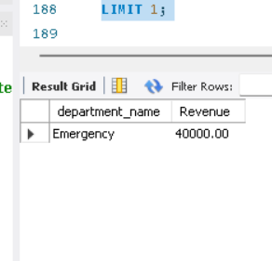
Department Generating Highest Revenue
SELECT dep.department_name, SUM(b.total_amount) Revenue FROM Bills b JOIN Admissions a ON b.admission_id=a.admission_id JOIN Doctors d ON a.doctor_id=d.doctor_id JOIN Departments dep ON d.department_id=dep.department_id GROUP BY dep.department_name ORDER BY Revenue DESC LIMIT 1;

Slide 20
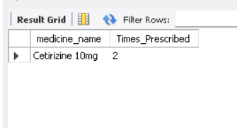
Most Frequently Prescribed Medicine
SELECT m.medicine_name, COUNT(*) AS Times_PrescribedFROM Prescriptions pJOIN Medicines mON p.medicine_id=m.medicine_idGROUP BY m.medicine_nameORDER BY Times_Prescribed DESCLIMIT 1;

Slide 21
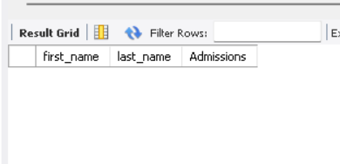
Patients Admitted More Than Once
SELECT p.first_name, p.last_name, COUNT(a.admission_id) AS AdmissionsFROM Patients pJOIN Admissions aON p.patient_id=a.patient_idGROUP BY p.patient_id,p.first_name,p.last_nameHAVING COUNT(*)>1;

Slide 22
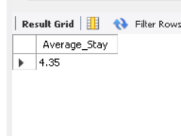
Average Hospital Stay
SELECTROUND(AVG(DATEDIFF(discharge_date,admission_date)),2)AS Average_StayFROM Admissions;

Slide 23
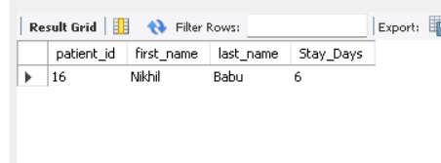
Longest Hospital Stay
SELECTp.patient_id,p.first_name,p.last_name,DATEDIFF(a.discharge_date,a.admission_date)AS Stay_DaysFROM Admissions aJOIN Patients pON a.patient_id=p.patient_idORDER BY Stay_Days DESCLIMIT 1;

Slide 24
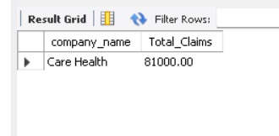
Insurance Company with Highest Claims
SELECTcompany_name,SUM(claim_amount) AS Total_ClaimsFROM InsuranceGROUP BY company_nameORDER BY Total_Claims DESCLIMIT 1;

Slide 25
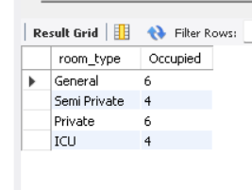
Room Occupancy
SELECTr.room_type,COUNT(a.room_id) AS OccupiedFROM Rooms rLEFT JOIN Admissions aON r.room_id=a.room_idGROUP BY r.room_type;

Slide 26
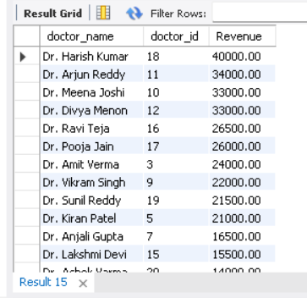
Doctor-wise Revenue
SELECTd.doctor_name,d.doctor_id,SUM(b.total_amount) AS RevenueFROM Doctors dJOIN Admissions aON d.doctor_id=a.doctor_idJOIN Bills bON a.admission_id=b.admission_idGROUP BY d.doctor_idORDER BY Revenue DESC;

Slide 27
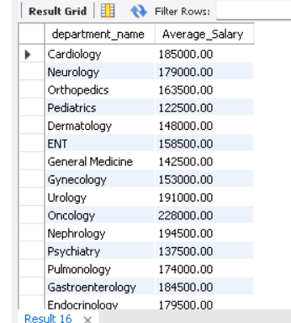
Department-wise Average Salary
SELECTdep.department_name,ROUND(AVG(s.net_salary),2) Average_SalaryFROM Doctors dJOIN Salary sON d.doctor_id=s.doctor_idJOIN Departments depON d.department_id=dep.department_idGROUP BY dep.department_name;

Slide 28
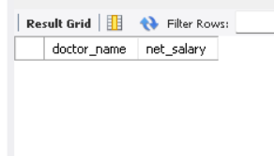
Doctors Earning More Than Department Average
SELECTd.doctor_name,s.net_salaryFROM Doctors dJOIN Salary sON d.doctor_id=s.doctor_idWHERE s.net_salary >(SELECT AVG(s2.net_salary)FROM Doctors d2JOIN Salary s2ON d2.doctor_id=s2.doctor_idWHERE d2.department_id=d.department_id);

Slide 29
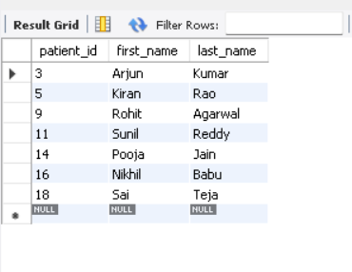
Patients Having Insurance and Pending Bills
SELECTp.patient_id,p.first_name,p.last_nameFROM Patients pWHERE EXISTS(SELECT 1FROM Insurance iWHERE i.patient_id=p.patient_id)AND EXISTS(SELECT 1FROM Bills bWHERE b.patient_id=p.patient_idAND b.payment_status='Pending');

Slide 30
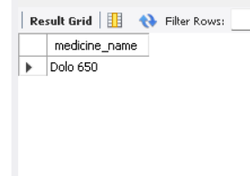
Medicines Never Prescribed
SELECTm.medicine_nameFROM Medicines mWHERE NOT EXISTS(SELECT 1FROM Prescriptions pWHERE p.medicine_id=m.medicine_id);

Slide 31
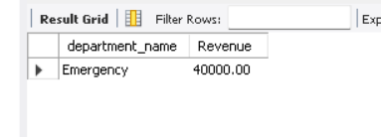
Top Revenue Department
WITH RevenueCTE AS(SELECTdep.department_name,SUM(b.total_amount) RevenueFROM Bills bJOIN Admissions aON b.admission_id=a.admission_idJOIN Doctors dON a.doctor_id=d.doctor_idJOIN Departments depON d.department_id=dep.department_idGROUP BY dep.department_name)SELECT *FROM RevenueCTEORDER BY Revenue DESCLIMIT 1;

Slide 32
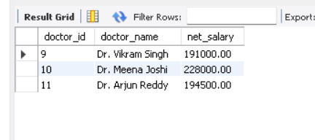
Doctors Paid More Than ALL Doctors in Department 1
SELECTd.doctor_id,d.doctor_name,s.net_salaryFROM Doctors dJOIN Salary sON d.doctor_id=s.doctor_idWHERE s.net_salary > ALL(SELECT s2.net_salaryFROM Doctors d2JOIN Salary s2ON d2.doctor_id=s2.doctor_idWHERE d2.department_id=1);

Slide 33
Complete Patient Treatment Report (8+ JOINs)
SELECTp.first_name,p.last_name,d.doctor_name,dep.department_name,r.room_number,lt.test_name,m.medicine_name,b.total_amount,pay.payment_status,i.company_nameFROM Patients pJOIN Admissions a ON p.patient_id=a.patient_idJOIN Doctors d ON a.doctor_id=d.doctor_idJOIN Departments dep ON d.department_id=dep.department_idJOIN Rooms r ON a.room_id=r.room_idLEFT JOIN Laboratory_Tests lt ON p.patient_id=lt.patient_idLEFT JOIN Prescriptions pr ON p.patient_id=pr.patient_idLEFT JOIN Medicines m ON pr.medicine_id=m.medicine_idLEFT JOIN Bills b ON a.admission_id=b.admission_idLEFT JOIN Payments pay ON b.bill_id=pay.bill_idLEFT JOIN Insurance i ON p.patient_id=i.patient_idORDER BY p.patient_id;

Slide 34
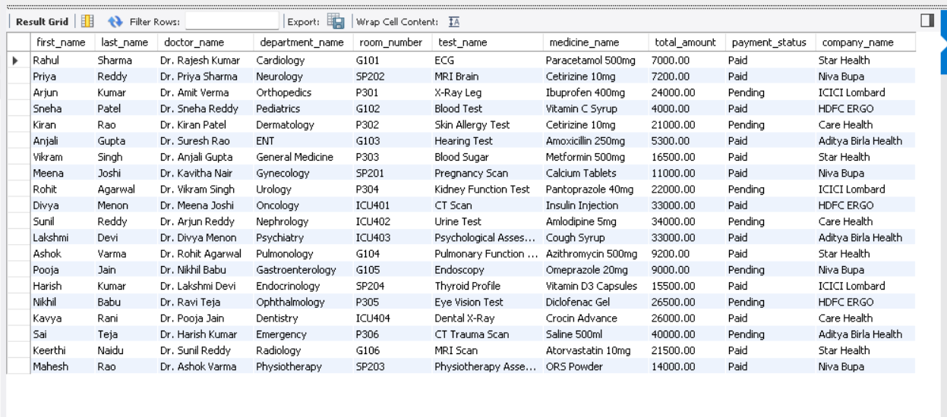

Slide 35

Conclusion
The Hospital Management System is a well-structured and normalized SQL-based solution that efficiently manages essential hospital operations such as patients, doctors, departments, appointments, admissions, medicines, prescriptions, laboratory tests, billing, payments, staff, nurses, rooms, salaries, and insurance. It maintains strong relationships between data, ensures data integrity and consistency, and supports efficient querying. The system is suitable for educational purposes, presentations, and further development into a complete hospital management application.

Slide 36
Thank you !

